Slide 1
Chapter 15: Bus Interface

Slide 2
Introduction
This chapter presents the ISA (industry standard architecture) bus, the PCI (peripheral component interconnect) and PCI Express buses, the USB (universal serial bus), and the AGP (advanced graphics port).
Also provided are some simple interfaces to many of these bus systems as design guides.

Slide 3
15–1 The ISA BUS
The Industry Standard Architecture, bus has been around since start of the IBM-PC
  circa 1982
Any card from the very first personal computer will plug in & function in any P4-based system.
  provided they have an ISA slot
ISA bus mostly gone from the home PC, but still found in many industrial applications.
  due to low cost & number of existing cards

Slide 4
Evolution of the ISA Bus
Over years, the ISA bus evolved from original 8-bit, to the 16-bit standard found today.
With the P4, ISA bus started to disappear.
  a 32-bit version called the EISA bus (Extended ISA) has also largely disappeared
What remains today is an ISA slot that can accept 8-bit ISA or 16-bit ISA cards.
32-bit printed circuit cards are now PCI bus
  in some older 80486 systems, VESA cards

Slide 5
The 8-Bit ISA Bus Output Interface
Fig 15–1 shows an 8-bit ISA connector as found on the main board of all PC systems
  may be combined with a 16-bit connector
The ISA bus connector contains
  the demultiplexed address bus (A₁₉–A₀) for
  the 1M-byte 8088 system
  the 8-bit data bus (D₇–D₀)
  control signals MEMR, MEMW, IOR, and IOW for controlling I/O and any memory placed on the printed circuit card

Slide 6
Memory is seldom added to ISA today because ISA cards operate at only 8 MHz.
  EPROM or flash memory for setup may be
  on some ISA cards, but never RAM
Other signals, useful for I/O interface, are
the interrupt request lines IRQ₂–IRQ₇.
DMA channel 0–3 control signals are also present on the connector.
DMA request inputs are labeled DRQ₁–DRQ₃ and the DMA acknowledge outputs are labeled DACK0 - DACK3.

Slide 7
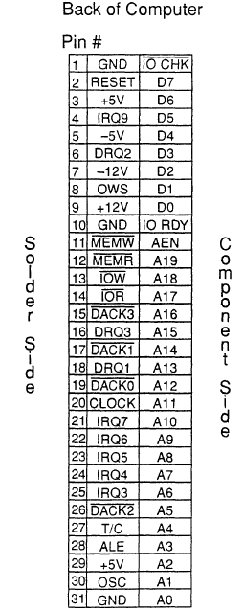
Figure 15–1 The 8-bit ISA bus.
  IRQ₂ is redirected to IRQ₉ on modern systems, and is so labeled here
  note the DRQ₀ input pin is missing,
  early PCs used DRQ₀ & the DACK₀ output as a refresh signal to refresh DRAM on the ISA card
  today, this output pin contains a
  15.2 µs clock signal used for
  refreshing DRAM
  remaining pins are for power
  and RESET

Slide 8
Fig 15–2 shows an interface for the ISA bus, which provides 32 bits of parallel TTL data.
  this example system shows some important points about any system interface
It is extremely important that loading to the bus be kept to one low-power (LS) TTL load.
  a 74LS244 buffer reduces loading on the bus
If all bus cards were to present heavy loads, the system would not operate properly.
  perhaps not at all

Slide 9
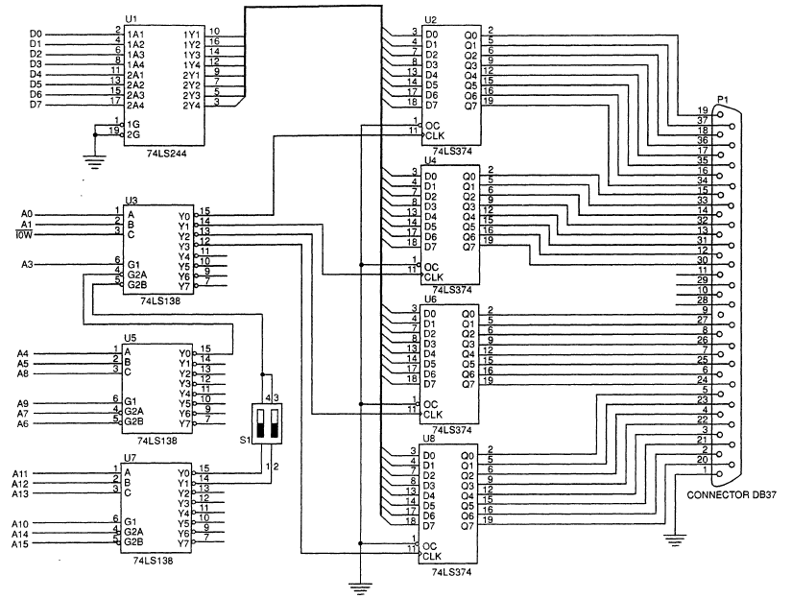
Figure 15–2 A 32-bit parallel port interfaced to the 8-bit ISA bus.

Slide 10
In the PC, the ISA bus is designed to operate at I/O address 0000H through 03FFH.
Newer systems often allow ISA ports above 03FFH, but older systems do not.
  some older cards only decode 0000H–03FFH
  & may conflict with addresses above 03FFH
The ports in 15–2 are decoded by three 74LS138 decoders.
  more efficient and cost-effective to decode
  the ports with a programmable logic device

Slide 11
The 8-Bit ISA Bus Input Interface
Figure 15–4 shows an input interface to the ISA bus, using a pair of ADC804 analog-to-digital converters.
  made through a nine-pin DB₉ connector
Decoding I/O port addresses is more complex, as each converter needs:
  a write pulse to start a conversion
  a read pulse to read the digital data converted
  a pulse to enable the selection of the INTR output

Slide 12
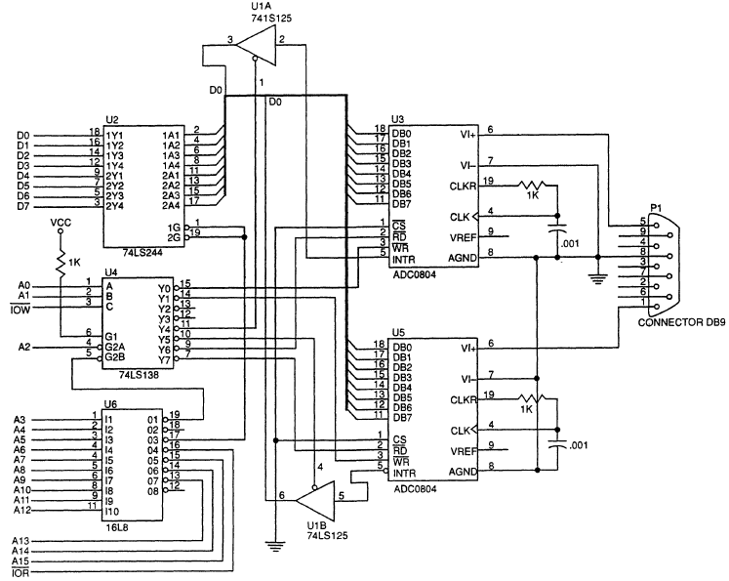
Figure 15–4 A pair of analog-to-digital converters interfaced to the ISA bus.

Slide 13
The 16-Bit ISA Bus
The difference between 8- & 16-bit ISA is an extra connector behind the 8-bit connector.
A 16-bit card contains two edge connectors:
  one plugs into the original 8-bit connector
  the other plugs into the new 16-bit connector
Figure 15–5 shows pin-out and placement
of the additional connector in relation to the
8-bit connector.

Slide 14
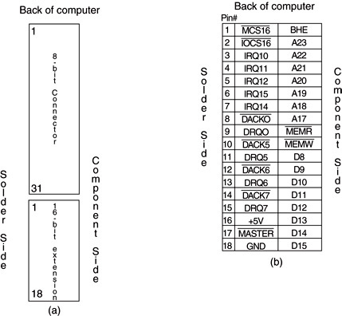
Figure 15–5 The 16-bit ISA bus. (a) Both 8- and 16-bit connectors and (b) the pinout of the 16-bit connector.

Slide 15
15–2 PERIPHERAL COMPONENT INTERCONNECT (PCI) BUS
PCI (peripheral component interconnect)
is virtually the only bus found in new systems.
  ISA still exists by special order for older cards
PCI has replaced the VESA local bus.
PCI has plug-and-play characteristics and
ability to function with a 64-bit data bus.

Slide 16
A PCI interface contains registers, located in a small memory device containing information about the board.
  this allows PC to automatically configure the card
  this provides plug-and-play characteristics to the ISA bus, or any other bus
Called plug-and-play (PnP), it is the reason PCI has become so popular.
Figure 15–6 shows the system structure
for the PCI bus in a PC system.

Slide 17
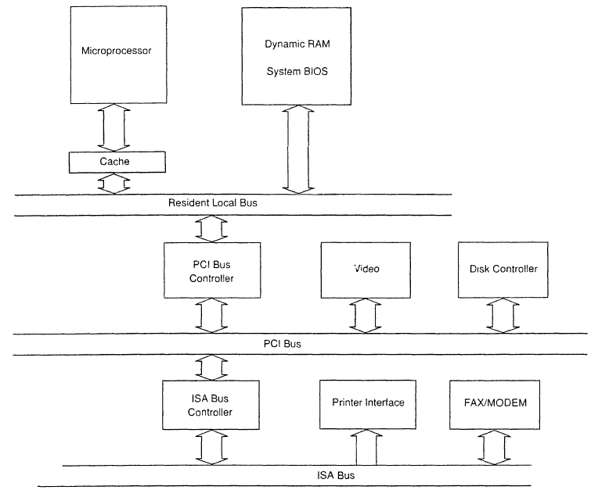
Figure 15–6 System block diagram for the PC that contains a PCI bus.
  the microprocessor connects to the PCI bus through an IC called a PCI bridge
  virtually any processor can interface to PCI with a bridge
  The resident local bus is
  often called a front side bus

Slide 18
The PCI Bus Pin-Out
PCI functions with a 32- or 64-bit data bus
and a full 32-bit address bus.
  address and data buses, labeled AD₀–AD₆₃ are multiplexed to reduce size of the edge connector
A 32-bit card has connections 1 through 62, the 64-bit card has all 94 connections.
The 64-bit card can accommodate a 64-bit address if required at some future point.
Figure 15–7 shows the PCI bus pin-out.

Slide 19
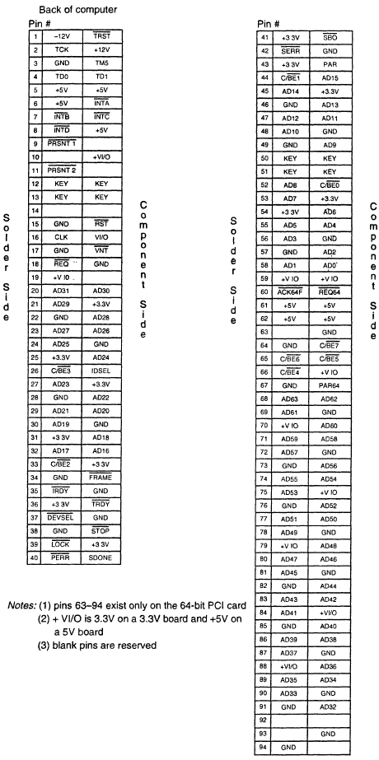
Figure 15–7 The pin-out of the PCI bus.
  PCI is most often used for I./O interface to the microprocessor
  memory could be interfaced, but with a Pentium, would operate
  at 33 MHz, half the speed of the Pentium resident local
  PCI 2.1 operates at 66 MHz, and 33 MHz for older interface cards
  P4 systems use 200 MHz bus speed (often listed as 800 MHz)
  there is no planned modification to the PCI bus speed yet

Slide 20
The PCI Address/Data Connections
The PCI address appears on AD₀–AD₃₁ and
is multiplexed with data.
  some systems have a 64-bit data bus using
  AD₃₂–AD₆₃ for data transfer only
  these pins can be used for extending the
  address to 64 bits
Fig15–8 shows the PCI bus timing diagram
  which shows the address multiplexed with data and control signals used for multiplexing

Slide 21
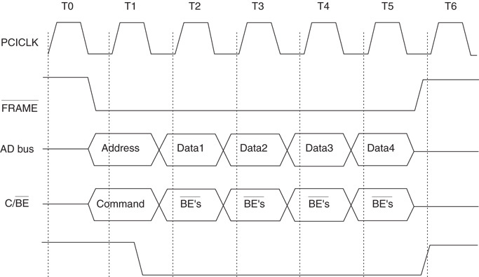
Figure 15–8 The basic burst mode timing for the PCI bus system. Note that this transfers either four 32-bit numbers (32-bit PCI) or four 64-bit numbers (64-bit PCI).

Slide 22
Configuration Space
PCI contains a 256-byte memory to allow
the PC to interrogate the PCI interface.
  this feature allows the system to automatically configure itself for the PCI plug-board
  Microsoft calls this plug-and-play (PnP)
The first 64 bytes contain information about the PCI interface.
The first 32-bit doubleword contains the unit
ID code and the vendor ID code.
Fig15–9 shows the configuration memory.

Slide 23
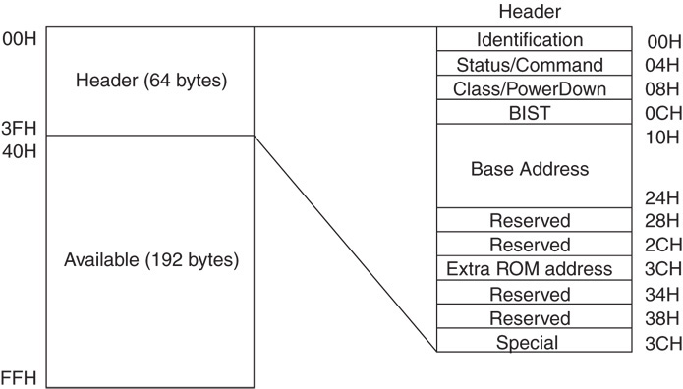
Figure 15–9 The contents of the configuration memory on a PCI expansion board.

Slide 24
Unit ID code is a 16-bit number (D₃₁–D₁₆).
  a number between 0000H & FFFEH to
  identify the unit if it is installed
  FFFFH if the unit is not installed
The class code is found in bits D₃₁–D₁₆ of configuration memory at location 08H.
  class codes identify the PCI interface class
  bits D₁₅–D₀ are defined by the manufacturer
Current class codes are listed in Table 15–5 and are assigned by the PCI SIG.

Slide 25
The base address space consists of a base address for the memory, a second for the I/O space, and a third for the expansion ROM.
Though Intel microprocessors use a 16-bit I/O address, there is room for expanding to 32 bits addressing.
The status word is loaded in bits D₃₁–D₁₆ of location 04H of the configuration memory.
  the command is at bits D₁₅–D₀ of 04H
Fig 15–10 shows the status & command registers.

Slide 26
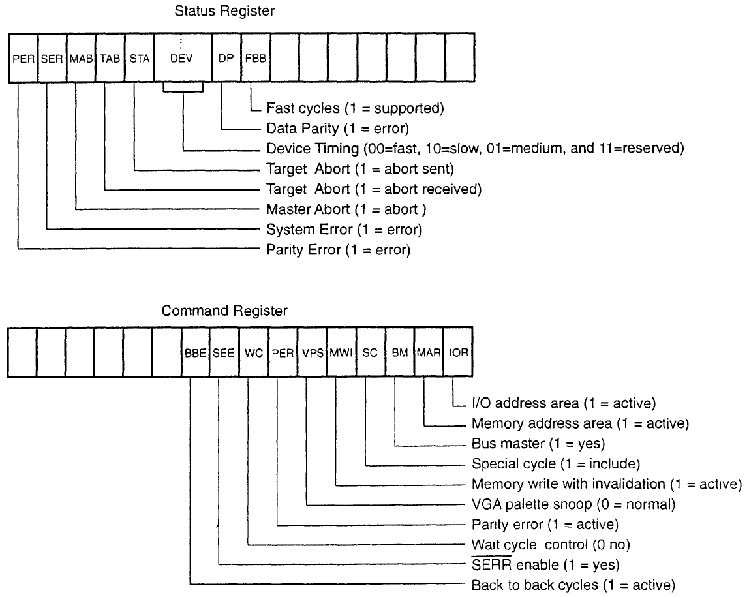
Figure 15–10 The contents of the status and control words in the configuration memory.

Slide 27
BIOS for PCI
Most modern PCs have an extension to the normal system BIOS that supports PCI bus.
  these systems access PCI at interrupt vector 1AH
Table 15–6 lists functions available through the DOS INT 1AH instruction with AH = 0B1H for the PCI.
Example 15–5 shows how the BIOS is used
to determine whether the PCI bus extension available.

Slide 28
PCl Interface
If a PCI interface is constructed, a PCI controller is often used because of the complexity of this interface.
The basic structure of the PCI interface is illustrated in Figure 15–11.
  the diagram illustrates required components
  for a functioning PCI interface
Registers, Parity Block, Initiator, Target, and Vendor ID EPROM are required components of any PCI interface.

Slide 29
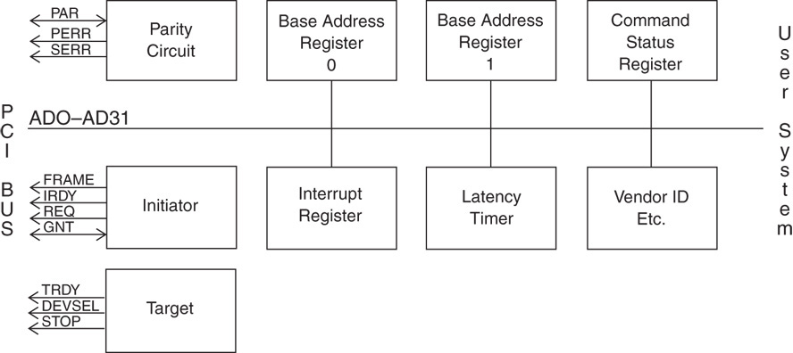
Figure 15–11 The block diagram of the PCI interface.

Slide 30
PCI Express Bus
The PCI Express transfers data in serial at
2.5 GHz to legacy PCI applications,
  250 MBps to 8 GBps for PCI Express interfaces
  standard PCI delivers data at about 133 MBps
Each serial connection on the PCI Express bus is called a lane.
  slots on the main board are single lane slots
  with a total transfer speed of 1 GBps
A PCI Express video card connector currently has 16 lanes with a transfer speed of 4 GBps.

Slide 31
The standard allows up to 32 lanes.
  at present the widest is the 16 lanes video card
Most main boards contain four single lane slots for peripherals and one 16 lane slot for the video card.
  a few newer boards contain two 16 lane slots
PCI Express 2 bus was released in late 2007.
  transfer speed from 250 MBps to 500 MBps,
  twice that of the PCI Express
PCI is replacing most current video cards on the AGP port with the PCI Express bus.

Slide 32
This technology allows manufacturers to use less space on the main board and reduce the cost of manufacturing a main board.
  connectors are smaller, which also reduces cost
Software used with PCI Express remains the same as used with the PCI bus.
  new programs are not needed to develop drivers
The connector is a 36-pin connector as illustrated in Figure 15–12.

Slide 33
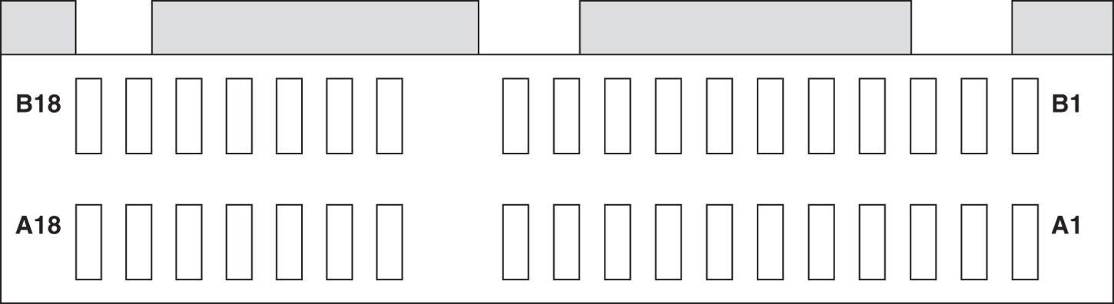
Figure 15–12 The single lane PCI Express connector.
  the pin-out for the single lane connector,
  appears in Table 15–7
  signaling on the PCI Express bus uses 3.3 V
  with differential signals degrees out of phase
  the lane is constructed from a pair of data pipes, one for input data and one for output data

Slide 34
15–3 THE PARALLEL PRINTER INTERFACE (LPT)
The parallel printer interface (LPT) is located on the rear of the PC.
LPT stands for line printer.
The printer interface gives the user access
to eight lines that can be programmed to receive or send parallel data.

Slide 35
Port Details
The parallel port (LPT₁) is normally at I/O addresses 378H, 379H, & 37AH from DOS.
  or by using a driver in Windows
The secondary (LPT₂) port, if present, is located at 278H, 279H, & 27AH.
The connectors are shown in Figure 15–13.

Slide 36
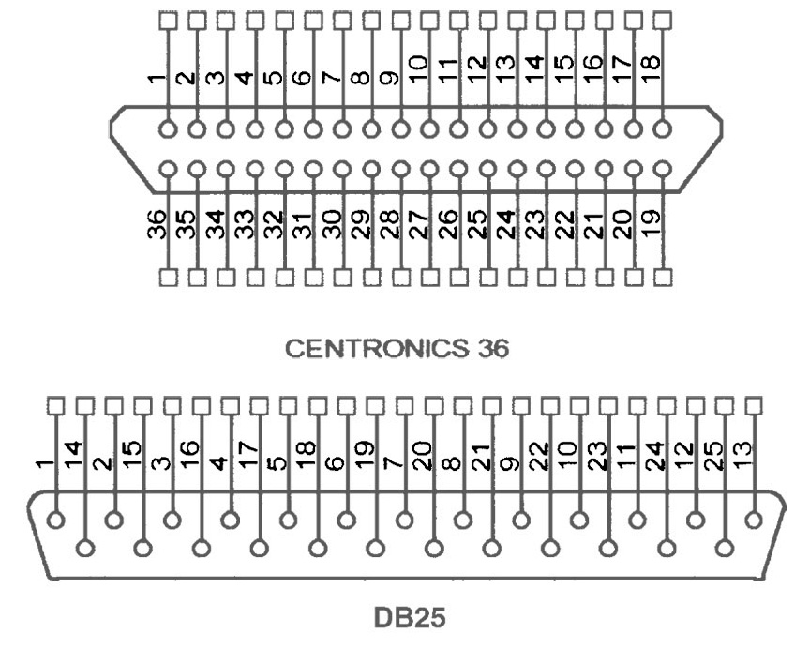
Figure 15–13 The connectors used for the parallel port.
  the Centronics interface on the parallel port uses two connectors
  a 25-pin D-type on the back of the PC
  a 36-pin Centronics on the back of the printer
  the pin-outs of these connectors are listed in
  Table 15–8

Slide 37
The parallel port can work as both a receiver and a transmitter at its data pins (D₀–D₇).
  allows other devices such as CD-ROMs, to be connected to and used by the PC through port
Anything that can receive and/or send data through an 8-bit interface can and often does connect to the parallel port (LPT₁) of a PC.
See Figure 15–14.

Slide 38
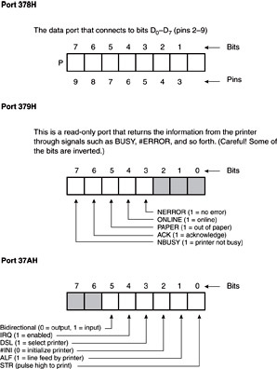
Figure 15–14 Ports 378H, 379H, and 37AH as used by the parallel port.
Shown here are the contents of:
  the data port (378H)
  the status register (379H)
  an additional status port (37AH)
  note that some of
  the status bits are true when logic 0

Slide 39
Using the Parallel Port Without ECP Support
For most systems since the PS/2, one can follow the information presented in Fig 15–14 to use the parallel port without ECP.
To read the port, it must be initialized by sending 20H to register 37AH. See Ex 15–6.
This sets the bidirectional bit to selects input operation for the parallel port.
  if the bit is cleared, output operation is selected

Slide 40
On 80286 systems, the bidirectional bit is missing from the interface.
  these systems do not have a register at 37AH
  to read information from the parallel port, write 0FFH to the port (378H), so that it can be read
Accessing the printer port from Windows is difficult because a driver must be written for Windows 2000 or Windows XP.
Windows 98 or Windows ME port access
is accomplished as explained for DOS.

Slide 41
A driver called UserPort (available on the Internet) opens up protected I/O ports in Windows 2000 & XP without using a driver.
This allows direct access to the parallel port through assembly blocks in Visual C++ using I/O port address 378H.
  also access to ports between 0000H & 03FFH
Another useful tool is available for a 30-day trial at http://www.jungo.com.

Slide 42
15–4 THE SERIAL COM PORTS
Serial communications ports are COM₁–COM₈
  most PCs have only COM₁ and COM₂ installed
Under DOS these ports are controlled and accessed with the 16550 serial interface.
Windows API functions operate the COM
ports for the 16550 communications interface.
USB devices often interface using the HID (human interface device) as a COM port.
  allows standard serial software to access USB

Slide 43
Communication Control
An example of a C++ function to access serial ports is listed in Example 15–9.
It is called WriteComPort, and it contains two parameters:
  first parameter is the port, as in COM₁, COM₂
  second is the character to send through the port
A return true indicates the character was sent.
  return false indicates a problem exists

Slide 44
To send the letter A through the COM₁ port call it with a WriteComPort (“COM₁”, “A”).
This function is written to send only a single byte through the serial COM port.
  but could be modified to send strings
To send 00H (no other number can be sent this way) through COM₂ use WriteComPort (“COM₂”, 0x00).
Note the COM port is set to 9600 baud.
  easily changed by changing the CBR_9600
  to another acceptable value

Slide 45
Receiving data is more challenging as errors occur more frequently than with transmission.
  many types of errors can be detected that often should be reported to the user
Example 15–10 shows a C++ function called ReadByte, which returns the character read from the port.
  or error code 0×100 if the port couldn’t be opened
  or 0×101 if the receiver detected an error
If data are not received, the function will hang because no timeouts were set.

Slide 46
15–5 THE UNIVERSAL SERIAL BUS
The universal serial bus (USB) has solved a problem with the PC system.
Current PCI sound cards use internal PC power, which generates a lot of noise.
  USB allows the sound card to have its own power supply, for high-fidelity sound with no 60 Hz hum
Other benefits are ease of connection and access to up to 127 different connections.
The interface is ideal for keyboards, sound cards, simple video-retrieval, and modems.

Slide 47
Data transfer speeds are 480 Mbps for full-speed USB 2.0 operation.
  11 Mbps for USB 1.1 compliant transfers
  1.5 Mbps for slow-speed operation
Cable lengths are limited to five meters for
the full-speed interface and three meters maximum for the low-speed interface.
Maximum power through the cables is rated at 100 mA, maximum current at 5.0 V.
  if current exceeds 100 mA, Windows will
  indicate an overload condition

Slide 48
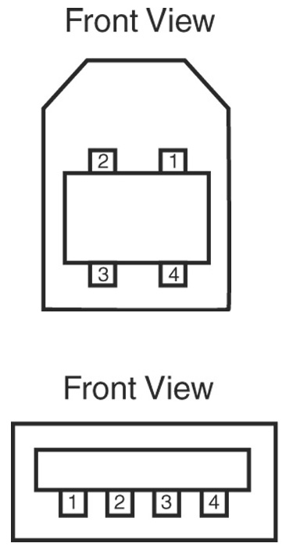
Figure 15–15 The front view of the two common types of USB connectors.
The Connector
  two types of connectors are specified, both are in use
  there are four pins on each connector, with signals
  indicated in Table 15–10
  the +5.0 V and ground can power devices connected to the bus
  data signals are biphase signals
  when +data are at 5.0 V, –data are at zero volts and vice versa

Slide 49
USB Data
Data signals are biphase signals generated using a circuit such as shown in Fig 15–16.
The line receiver is also shown.
A noise-suppression circuit available from Texas Instruments (SN75240) is placed on
the transmission pair
Once the transceiver is in place, interfacing
to the USB is complete.

Slide 50
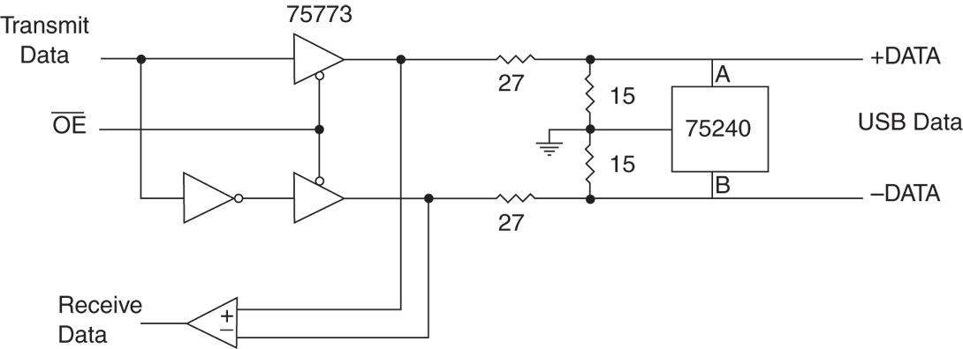
Figure 15–16 The interface to the USB using a pair of CMOS buffers.
  a 75773 IC from Texas Instruments functions as differential line driver and receiver here

Slide 51
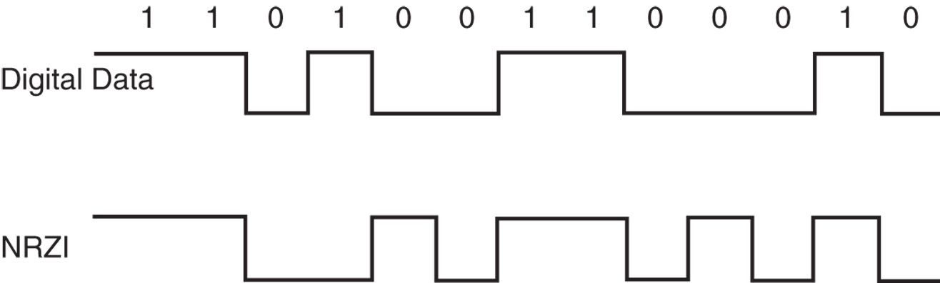
Figure 15–17 NRZI encoding used with the USB.
  USB uses NRZI (non-return to zero, inverted) encoding to transmit packet data
  this method does not change signal level for
  the transmission of logic 1
  signal level is inverted for each change to logic 0

Slide 52
Actual data transmitted includes sync bits, a method called bit stuffing, because it lengthens the data stream.
If logic 1 is transmitted for more than 6 bits in a row, the bit stuffing technique adds an extra bit (logic 0) after six continuous 1s in a row.
Bit stuffing ensures the receiver can maintain synchronization for long strings of 1s.
  data are always transmitted with the least-significant bit first, followed by subsequent bits
See Fig 15–18.

Slide 53
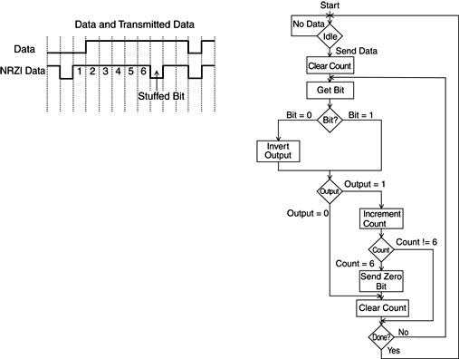
Figure 15–18 The data stream and the flowchart used to generate USB data.
  a bit-stuffed serial data stream and the algorithm used to create it from raw digital serial data

Slide 54
USB Commands
To begin communication, sync byte 80H is transmitted first, followed by the packet identification byte (PID).
The PID contains 8 bits.
  only the rightmost 4 bits contain the type
  of packet that follows, if any
The leftmost 4 bits of the PID are the ones complementing the rightmost 4 bits.

Slide 55
Figure 15–19 lists formats of data, token, handshaking, and start-of-frame packets.
  in the token packet, the ADDR (address field) contains the 7-bit address of the USB device
  up to 127 devices present on at a time
ENDP (endpoint) is a 4-bit number used by the USB.
  Endpoint 0000 is used for initialization
  other endpoints are unique to each USB device

Slide 56
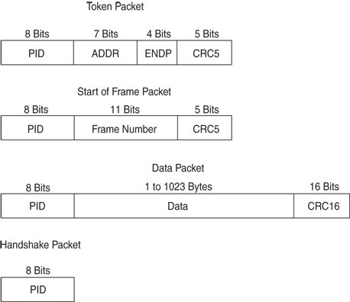
Figure 15–19 The types of packets and contents found on the USB.

Slide 57
Two types of CRC (cyclic redundancy checks) used on USB.
  5-bit CRC generated with polynomial X₅ + X₂ + 1
  a 16-bit CRC, used for data packets, generated with the X₁₆ + X₁₅ + X₂ + 1 polynomial
When using 5-bit CRC, a residual of 01100
is received for no error in all five bits of the CRC and the data bits.
  a 16-bit no error CRC residual is 1000000000001101

Slide 58
Once a packet is transferred from host to USB device, if data & CRC are received correctly, ACK (acknowledge) is sent to the host.
If data and CRC are not received correctly, the NAK (not acknowledge) is sent.
  if the host receives a NAK token, it retransmits
  the data packet until it is received correctly
This method of data transfer is often called stop and wait flow control.
  host must wait for client to send an ACK or
  NAK before transferring additional data packets

Slide 59
The USB Bus Node
National Semiconductor produces a USB bus interface easy to interface to the processor.
Connect this device using non-DMA access:
  connect the data bus to D₀–D₇
  connect control inputs RD, WR, and CS and a 24 MHz fundamental crystal across X_{In} and X_{Out} pins
The USB bus connection is located on the D– and D+ pins.
Figure 15–20 shows a USBN9604 USB node.

Slide 60
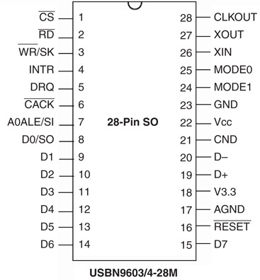
Figure 15–20 The USB bus node from National Semiconductor.
  USBN9604 is a USB bus transceiver that can receive and transmit USB data
  this provides an interface point to
  the USB bus for
  a minimal cost of about two dollars

Slide 61
Simplest interface is achieved by connecting the two mode inputs to ground.
This places the device into nonmultiplexed parallel mode.
  in this mode the A₀ pin is used to select
  address (1) or data (0)
Fig 15–21 shows this connection decodes
at I/O addresses 0300H (data) and 0301H (address)

Slide 62
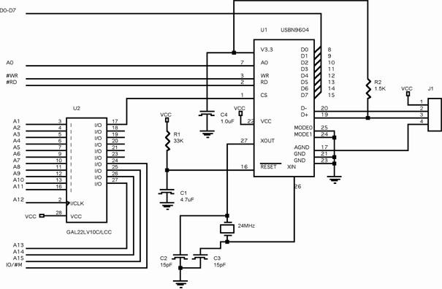
Figure 15–21 The USBN9604 interfaced to a microprocessor at I/O addresses 300H and 301H.

Slide 63
15–6 ACCELERATED GRAPHICS PORT (AGP)
The latest addition to most systems was the accelerated graphics port (AGP), until PCI Express became available for video.
It is designed for transfer between video card and system memory at a maximum speed.
  AGP transfers at a maximum of 2G bytes/sec

Slide 64
The main advantage of AGP over PCI bus is AGP can sustain transfers at speeds up to 2G bytes per second. (8X compliant system).
  4X system transfer rate is over 1G byte/sec
AGP is designed to allow high-speed transfer between the video card frame buffer and system memory through the chip set.
Fig 15–22 shows interface of the AGP to a
Pentium 4 system
  and placement of other buses in the system

Slide 65
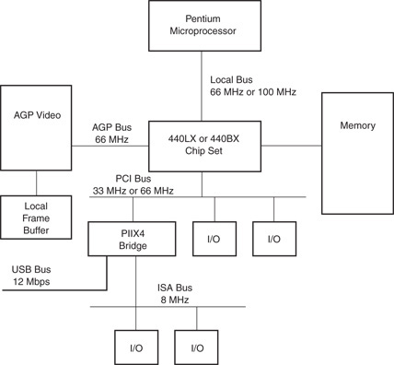
Figure 15–22 Structure of a modern computer, illustrating all the buses.

